Slide 1
LibreOffice Python - Part 4
Writing a Python Program for LibreOffice that is stored in the Document library. i.e. Embedded in the document file.
Hamilton Python User Group Presentation
2015 April 13
Ian Stewart
V1.0
https://github.com/hampug

Slide 2
Introduction: Inside a LibreOffice Document
LibreOffice uses the Open Document Format.
Open Document Format (ODF) is an international family of standards that is the successor of commonly used deprecated vendor specific document formats such as .doc, .wpd, .xls and .rtf. ODF is standardised at OASIS and adopted by ISO/IEC JTC1 SC34. Expect V1.2 ISO/IEC approved in 2015.
http://www.opendocumentformat.org/aboutODF/
Container Structure: ODF Package
Compression Format: ZIP
http://en.wikipedia.org/wiki/OpenDocument
Summary: A LibreOffice file is one zip file of many files and folders. The files extension starts with “.od”. The last character determines the application that created it. For example .odt for text writer, .ods for calc spreadsheet, .odp for Impress presentation, .odg for Draw graphics.

Slide 3
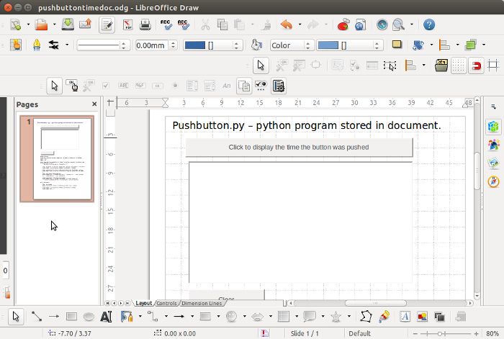
Introduction: Copy example libreoffice document in preparation for embedding python code inside the document.

Slide 4
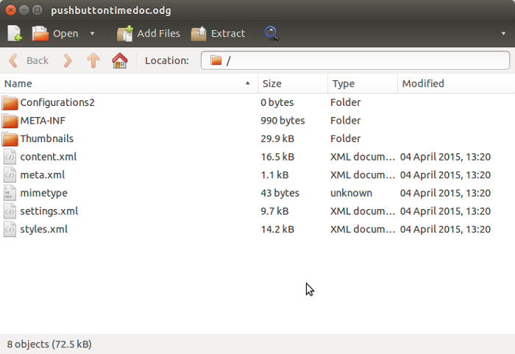
Introduction: Archive Manager view of example LibreOffice document

Slide 5
Steps to move a python program from User Library to the Document library.
Unzip LibreOffice document files into a /tmp subdirectory.
Create in /tmp subdirectory the Scripts and python folders.
Copy the python program from the User library to /tmp/subdirectory /Scripts/python folder.
Into manifest.xml file insert the extra python folder and file names.
In the content.xml file, change the event-listeners to be in the document.
Re-zip the /tmp files back to a LibreOffice document. The minetype file must be first file in the zip archive.
Doing the above six steps manually at the bash command line is difficult. The next 20 slides describe the python program, pyinsert.py, that does the above.

Slide 6
Step1a: Unzip LibreOffice document files into a /tmp subdirectory
import zipfile
path = "/home/ian/pyuno for libreoffice/"
filename = "pushbuttontimedoc.odg"
temp_directory = "/tmp/lounziped/"
def unzip(path, filename, temp_directory):
"""
Using the supplied path, unzip the LibreOffice file into the temporary
directory. /tmp/lounzip
"""
with zipfile.ZipFile(path + filename, "r") as z:
z.extractall(temp_directory)
The new copy of the python Draw file which still has pushbuttons that use the python script in the User library, is unzipped into a /tmp subdirectory.

Slide 7
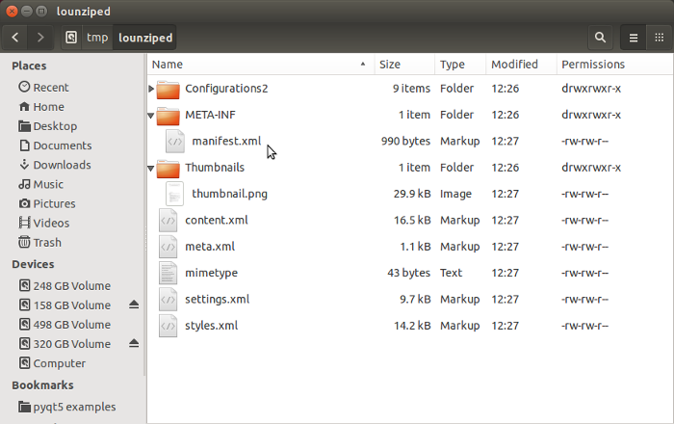
Step1b: View of example libreoffice document unzipped into a /tmp subdirectory.
Files of interest: manifest.xml, content.xml and mimetype
FYI: Configuratons2 contains 9 x subfolders and 1 file.

Slide 8
Step2a: Create in /tmp subdirectory the Scripts/python folders.
import os
temp_directory = "/tmp/lounziped/"
# Make the Scripts/python/ folder if it doesn't already exist
os.makedirs(temp_directory + "Scripts/python/", mode=0o777, exist_ok=True)
“Script” folder and “python” sub-folder are created in the /tmp subdirectory.
os.makedirs. If exist_ok is False (the default), an OSError is raised if the target directory already exists.

Slide 9
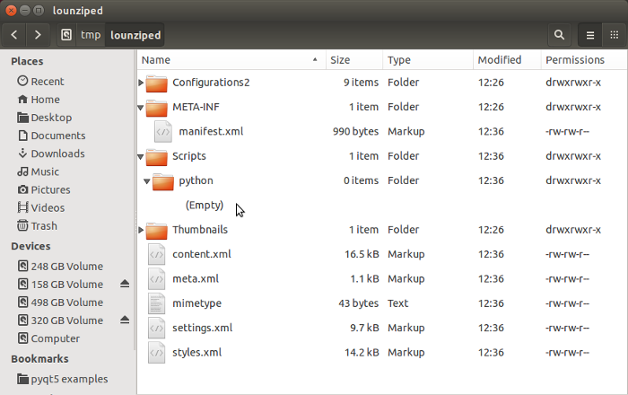
Step2b: Create in /tmp subdirectory the Scripts/python folders.
Scripts and python folders now exists in /tmp subdirectory

Slide 10
Step3a: Copy python program from User library to /tmp subdirectory /Scripts/python/.
import shutil
pypath = "/home/ian/.config/libreoffice/4/user/Scripts/python/"
pyfilename = "pushbutton.py"
temp_directory = "/tmp/lounziped/"
# Copy python file
shutil.copy2(pypath + pyfilename, temp_directory + "Scripts/python/")
Using shutil.copy2 preserves the modified date of the python file. This could help with revision control.

Slide 11
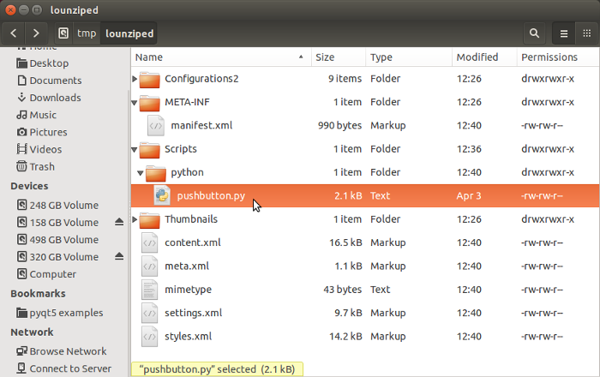
Step3b: Copy python program from User library to /tmp subdirectory /Scripts/python/.
...pushbutton.py now in python directory

Slide 12
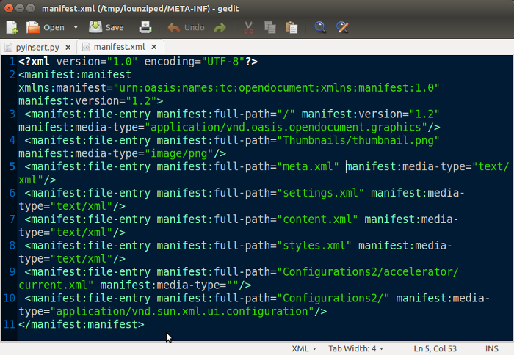
Step4a: Into the manifest.xml file insert the Scripts and python folders and the python file. Before inserting...

Slide 13
Step4b: Into the manifest.xml file insert the Scripts and python folders and the python file.
import os
manpath = temp_directory + "META-INF/"
manfilename = "manifest.xml"
pyfilename = "pushbutton.py"
def editmanifest(manpath, manfilename, pyfilename):
'''
Edit the /META-INF/manifest.xml file and insert Scripts, python and file.
'''
manifest_string1 = ('<manifest:file-entry manifest:full-path='
'"Scripts/" manifest:media-type="application/binary"/>')
manifest_string2 = ('<manifest:file-entry manifest:full-path='
'"Scripts/python/" manifest:media-type="application/binary"/>')
manifest_string3a = ('<manifest:file-entry manifest:full-path='
'"Scripts/python/')
manifest_string3b = pyfilename
manifest_string3c = ('" manifest:media-type=""/>')
If the manifest doesn't match the contents of the OpenOffice zip file then an error message occurs upon trying to launch the document. Don't leave behind in the /tmp directories old xxx.py~ files, etc., from editing.
Code continues on next slide...

Slide 14
Step4c: Into the manifest.xml file insert the Scripts and python folders and the python file.
def editmanifest(manpath, manfilename, pyfilename): continues...
identifier = ('<manifest:file-entry manifest:full-path='
'"content.xml" manifest:media-type="text/xml"/>')
# Rename the original manifest file.
os.rename(manpath + manfilename, manpath + "manifest_original.xml")
# Create a new manifest file and write original contents plus add the
# python related lines to the manifest
with open(manpath + "manifest_original.xml", 'r') as infile, \
open(manpath + manfilename, 'w') as outfile:
for line in infile:
outfile.write(line)
if identifier in line:
outfile.write("{}\n".format(manifest_string1,))
outfile.write("{}\n".format(manifest_string2,))
outfile.write("{}{}{}\n".format(manifest_string3a,
manifest_string3b, manifest_string3c))
# delete the original manifest file
os.remove(manpath + "manifest_original.xml")
...manifest.xml is now updated

Slide 15
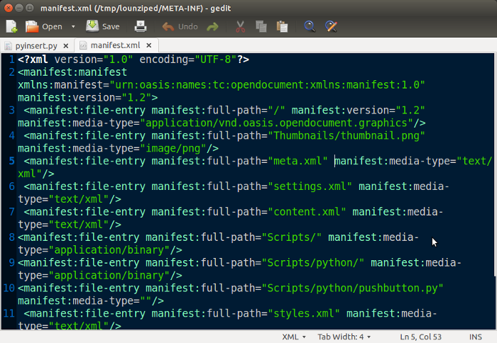
Step4d: Into the manifest.xml file insert the Scripts and python folders and the python file. After inserting...

Slide 16
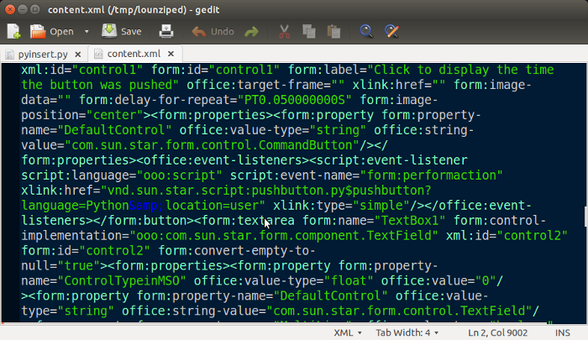
Step5a: In the content.xml file, change the event-listeners to be in the document. Before...
location=user

Slide 17
Step5b: In the content.xml file, change the event-listeners to be in the document..
contpath = temp_directory
contfilename = "content.xml"
def editcontent(contpath, contfilename):
'''
Change the content.xml file such that "location=user" is changed to
"location=document".
'''
# Rename the original content.xml file.
os.rename(contpath + contfilename, contpath + "content_original.xml")
# Read content_original.xml to a string, preserve newline characters
with open(contpath + "content_original.xml", "r") as infile:
content_string = infile.read()
# Split the string, based on space character, into a list.
# Use split(" ") to preserve newline character, if any.
content_list = content_string.split(" ")
User library xml listener-event link for the pushbutton: xlink:href="vnd.sun.star.script:pushbutton.py$pushbutton?language=Python&amp;location=user"
Code continues on next slide...

Slide 18
Step5c: In the content.xml file, change the event-listeners to be in the document..
contpath = temp_directory
contfilename = "content.xml"
def editcontent(contpath, contfilename): continues...
# Replace event-listener library pointer
counter = 0
for pointer, item in enumerate(content_list):
# For list entries with ';location=user"' change to'
# ;location=document"'
if item.find(';location=user"') != -1:)
counter +=1
item = item.replace(';location=user"',';location=document"')
content_list[pointer] = item
# Re-build the string and write as new file to the /tmp sub-directory
content_string = " ".join(content_list)
with open(contpath + contfilename, "w") as outfile:
outfile.write(content_string)
# delete the original content.xml file
os.remove(contpath + "content_original.xml")
...content.xml is now updated

Slide 19
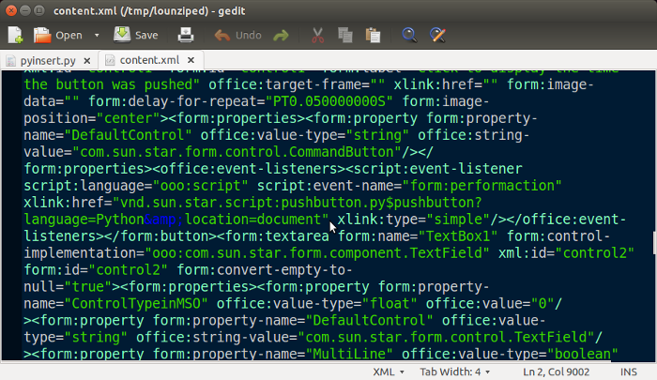
Step5d: In the content.xml file, change the event-listeners to be in the document. After...
location=document

Slide 20
Step6a: Re-zip the /tmp files back to a LibreOffice document Minetype file must be first file.
import os
import zipfile
import shutil
temp_directory = "/tmp/lounziped/"
pathnew = "/home/ian/pyuno for libreoffice/"
filenamenew = "pushbuttontimedoc_embeddedpy.odg"
def rezip(temp_directory, pathnew, filenamenew):
"""
Using the supplied path into /tmp, rezip the LibreOffice files.
The minetype file must be the first file in the zipped libreoffice
document.
Remove all files in /tmp
"""
# Walk the directory and retrieve a list of all paths and paths/filenames
retrieve_list = []
for root, dirs, files in os.walk(temp_directory, topdown=True):
# Retrieve the paths
for dir_name in dirs:
retrieve_list.extend([os.path.join(root, dir_name)])
# Retrieve path and filename
for file_name in files:
retrieve_list.extend([os.path.join(root, file_name)])
Code continues on next slide...

Slide 21
Step6b: Re-zip the /tmp files back to a LibreOffice document Minetype file must be first file.
import os
import zipfile
import shutil
def rezip(temp_directory, pathnew, filenamenew): continues...
# Create an archive list with pairs of data. E.g.
# [['/tmp/lounziped/mimetype', 'mimetype']
# ['/tmp/lounziped/content.xml', 'content.xml']]
# item[0] is the source in /tmp folder.
# item[1] is the destination used in the zip archive
archive_list = []
for item in retrieve_list:
# Remove the /tmp directory data from the start of item.
output = item[len(temp_directory):]
archive_list.append([item, output])
# Shift mimetype to the front of the archive_list so it will be first
# file written into the zip archive.
for pointer, item in enumerate(archive_list):
if item[1] == 'mimetype':
archive_list.insert(0, archive_list.pop(pointer))
Code continues on next slide...

Slide 22
Step6c: Re-zip the /tmp files back to a LibreOffice document Minetype file must be first file.
import os
import zipfile
import shutil
def rezip(temp_directory, pathnew, filenamenew): continues...
# Use the archive_list to build the new libreoffice zip file
# Opening new zip file as "w" removes previous version of file if it exists
with zipfile.ZipFile(pathnew + filenamenew, 'w') as rezipfile:
for item in archive_list:
rezipfile.write(item[0], item[1])
# Clean up. Remove the files that were in /tmp
shutil.rmtree(temp_directory)
...new LibreOffice document is now complete. Launch it and check the code

Slide 23
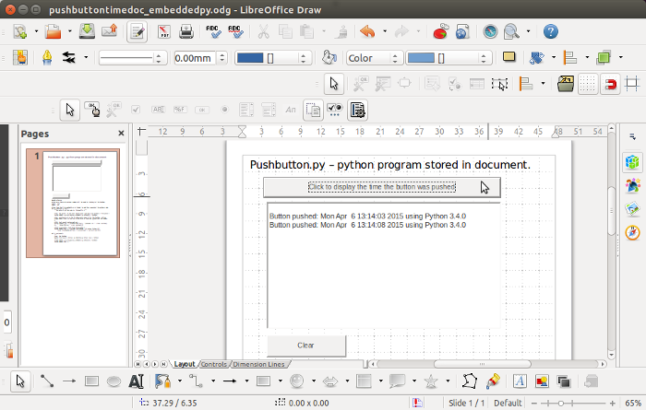
Step6d: Re-zip the /tmp files back to a LibreOffice document. Launch libreoffice document and click button...
Python code now executing from source embedded in document

Slide 24
End of Embedding the python code into a LibreOffice document
Some Observations:
No console window to see stdout. E.g. print(“hello”) disappears. Workaround write to a file and refresh the editor that has the file open.
Try launching libreoffice document from console window. $ soffice. But still error and stdout do not go to the console.
Code running from a libreoffice library can not import a module that is in the library. Adding __init__.py didn't help. Need to define path?
Only one concatination with a colon. E.g. This won't work if DEBUG: with open('/tmp/debug_info.txt', 'w') as f: f.write('something gone wrong')
Case sensitivity python/libreoffice.
pyinsert.py is available on https://github.com/hampug
#TODO:
Make the pyinsert.py code into a GUI.

Slide 25
Embedding the python code into a LibreOffice document
That ends the ways LibreOffice connects to python scripts in User, Share and Document macro libraries.
Next Month it's the opposite:
How a python script connects to LibreOffice!
(...which is much more simple and easier to understand)
pyinsert.py is available on https://github.com/hampug
#TODO:
Change pyinsert.py from having hard-coded variables to getting input through the command prompt as arguments when launching.
Use xml.etree.ElementTree to edit manifest and content.
Provide a GUI (e.g. tkinter) for pyinsert.py
Allow multiple folders and files to be transferred. Allow wildcards.
Check if folder names or need to be in the manifest.xml?
__end__.py
pyinsert.py is available on https://github.com/hampug
#TODO:
Make the pyinsert.py code into a GUI.

